Slide 1
What We Can Easily See
Ashwin Malshe, PhD

Slide 2

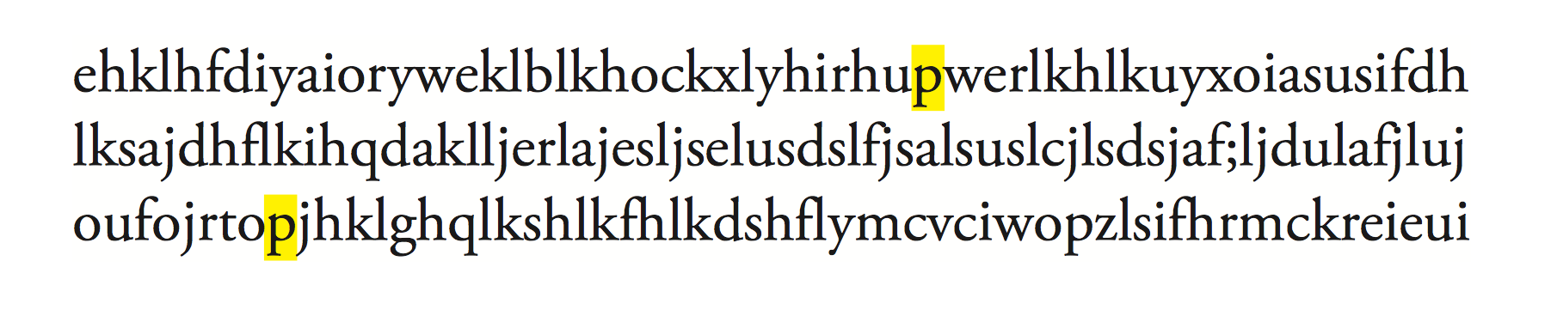
Spot ‘p’

Slide 3
Spot ‘q’

Slide 4
Why ps were so much easier to spot than qs?

Slide 5

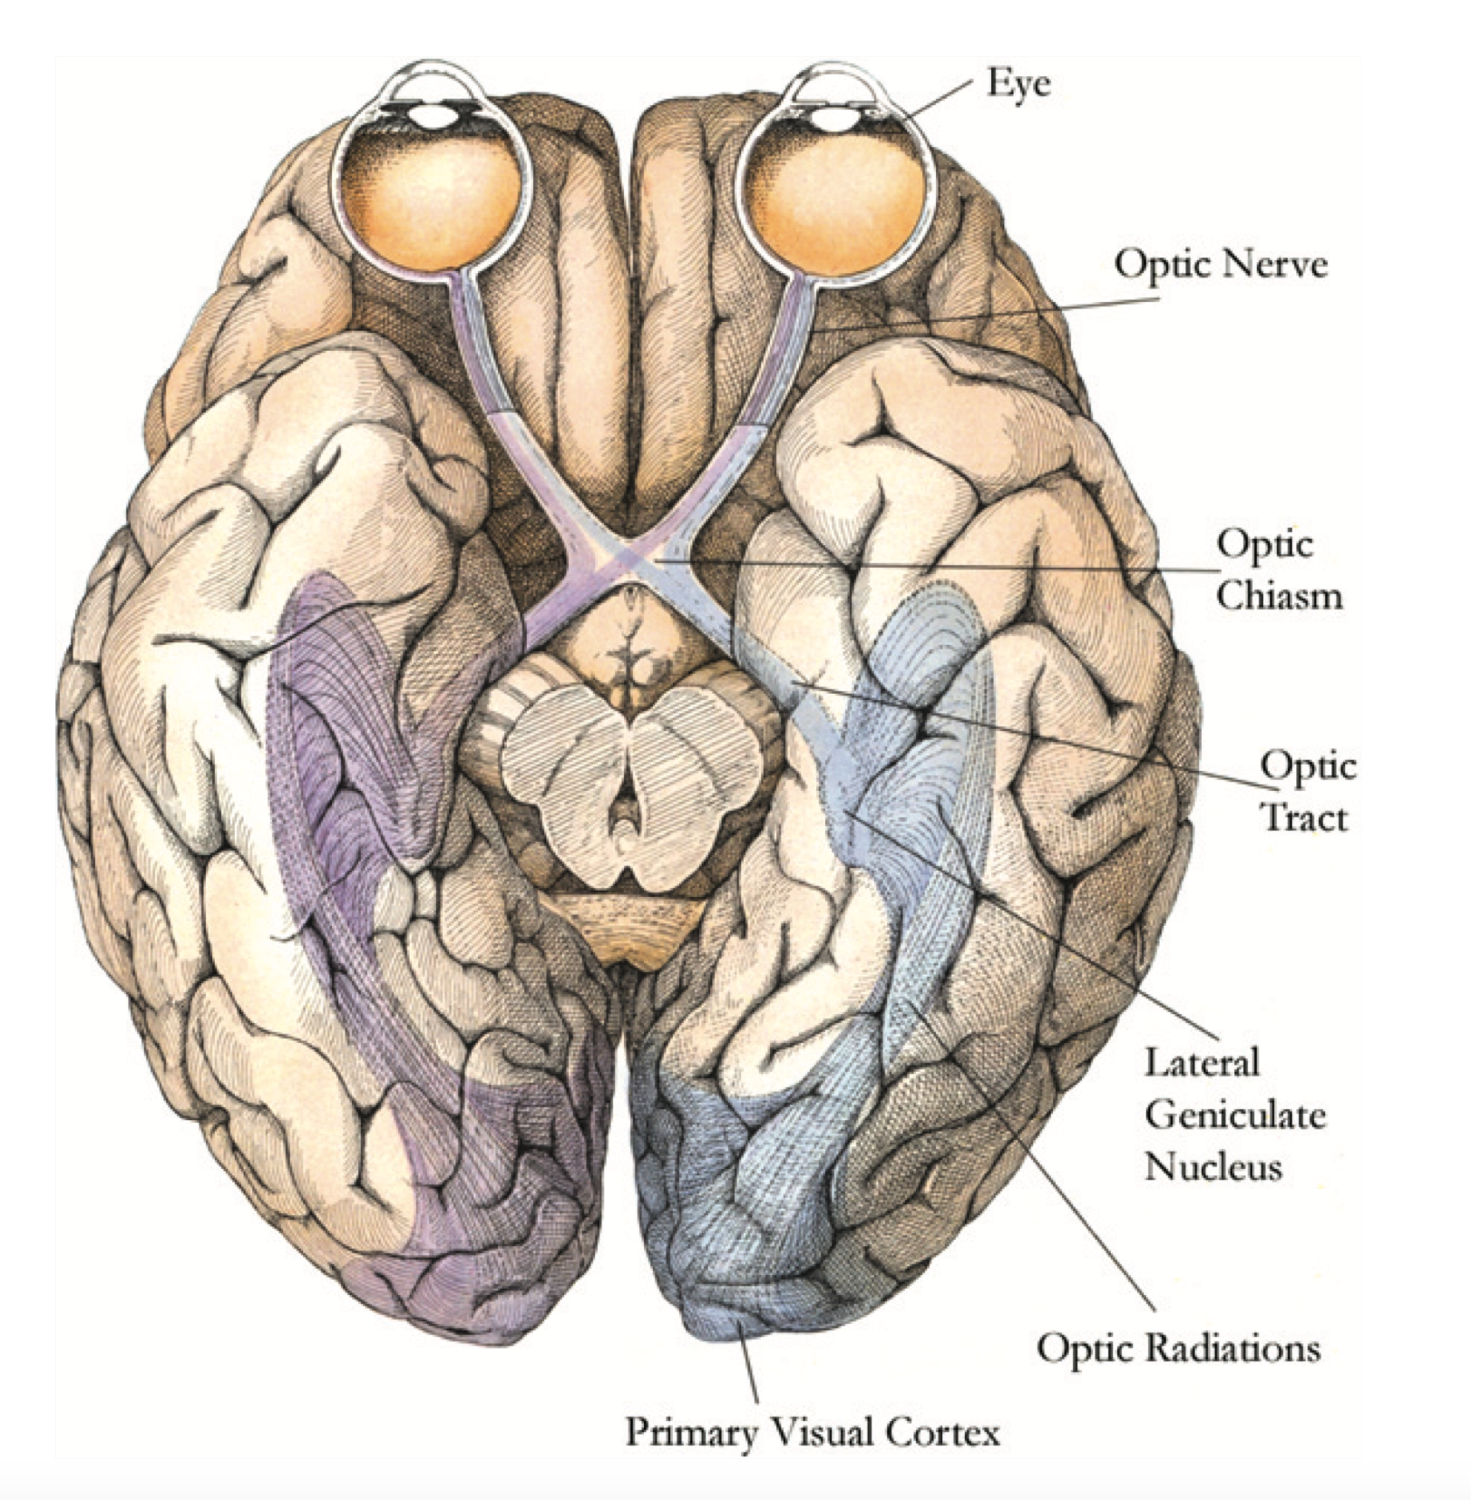
In the primary visual cortex billions of neurons process the entire image, providing the elements of form, color, texture, stereoscopic depth, and motion all at once.

Slide 6
What Pops Out?

Slide 7

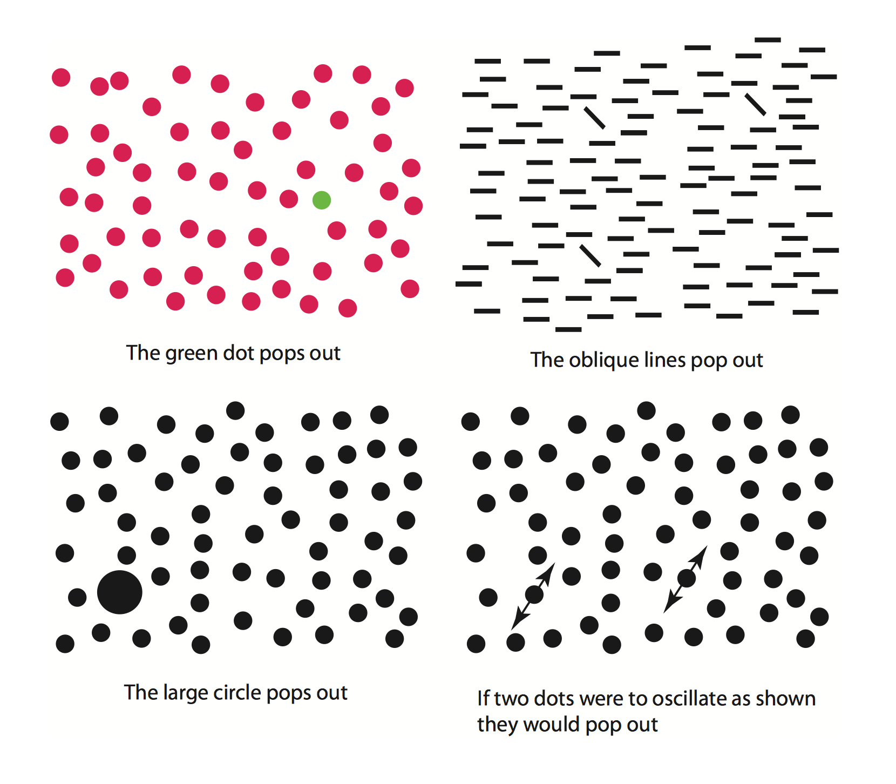

Slide 8
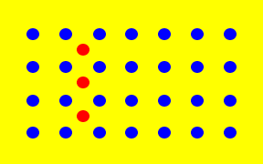

Slide 9
The strongest pop-out effects occur when
A single target object differs in some feature from all other objects and
Where all the other objects are identical, or at least very similar to one another.
The degree of feature-level contrast between an object and its surroundings makes it distinct

Slide 10
But…In what terms is the contrast defined?

Slide 11
Contrast is deﬁned in terms of the basic features that are processed in the primary visual cortex
Color
Motion
Size
Orientation
Stereoscopic depth

Slide 12
Examples

Slide 13

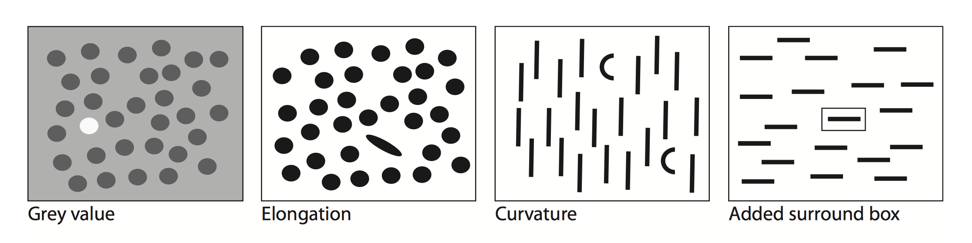

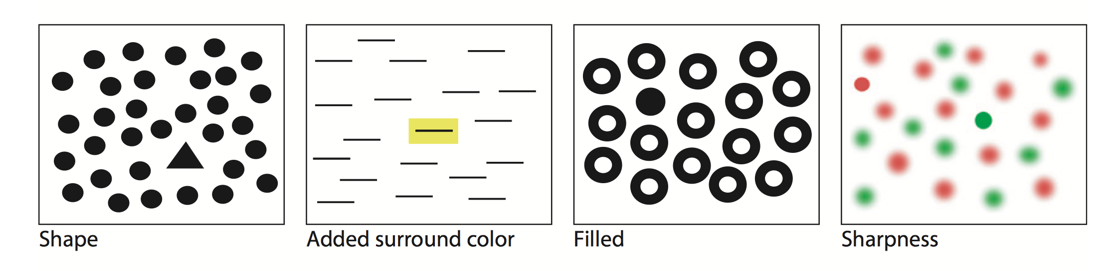

Slide 14

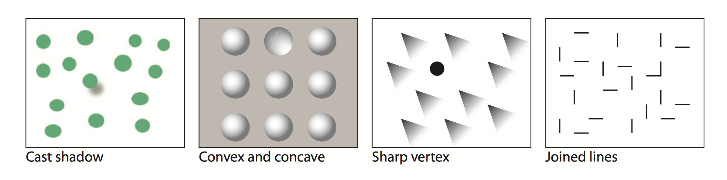

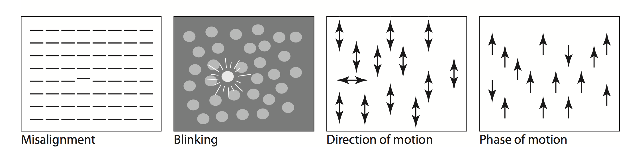

Slide 15

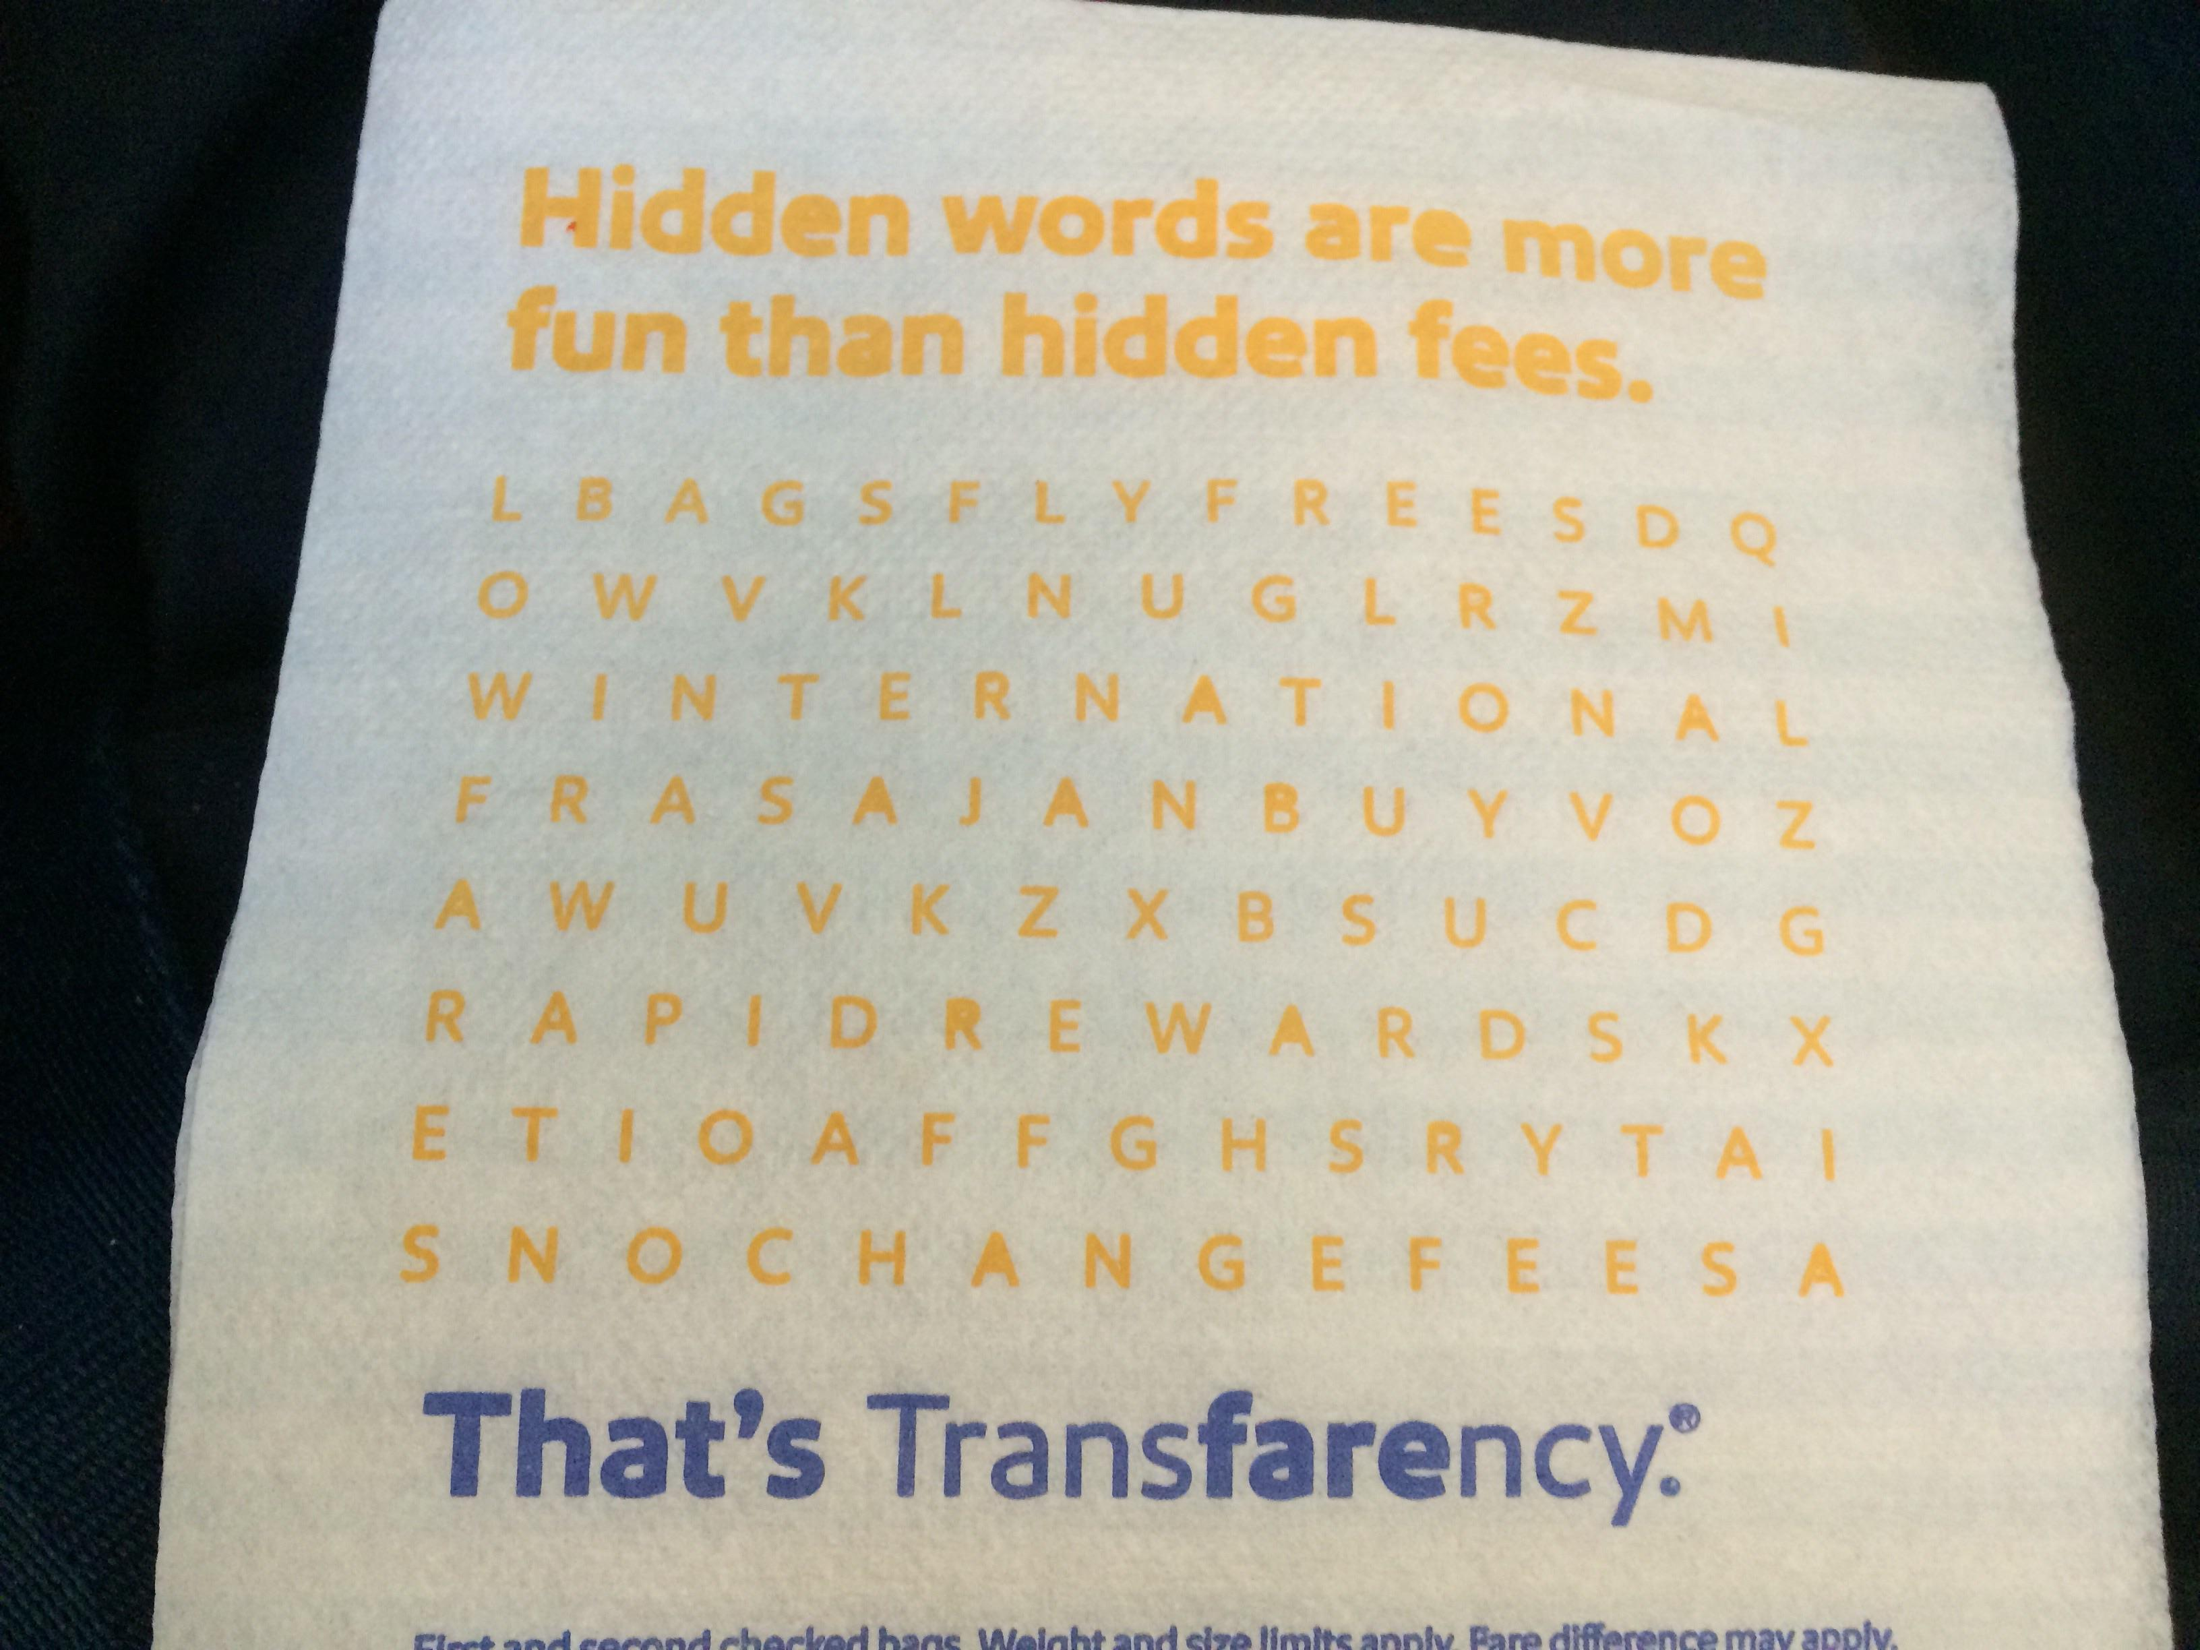

Slide 16

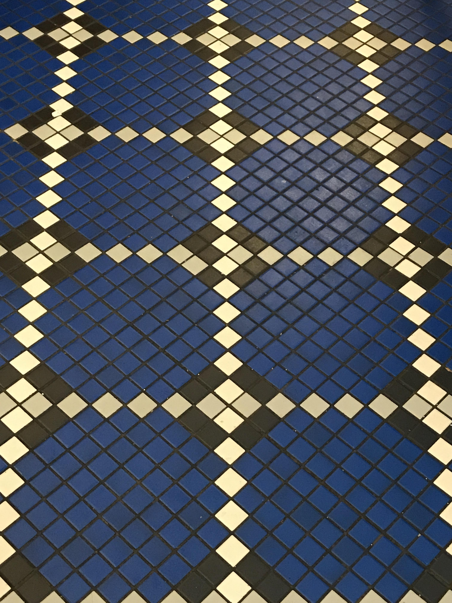
Do you see the imperfection?

Slide 17
Spot green squares

Slide 18

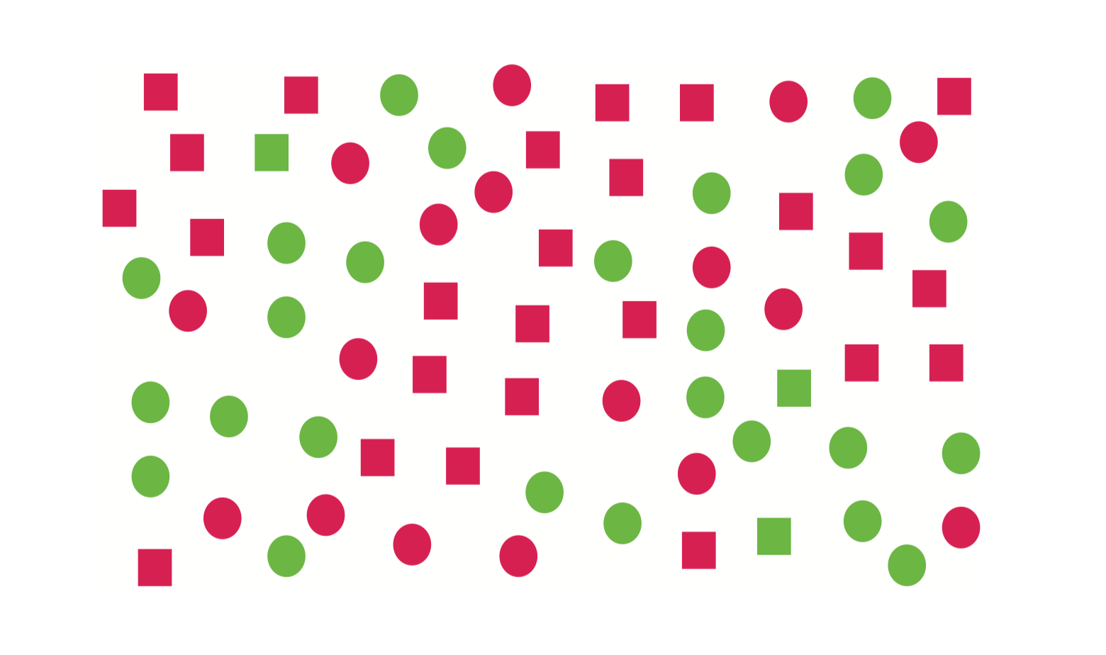

Slide 19
Primary visual cortex can either be tuned for the square shapes, or the green things, but not both
Trying to find a target based on two features is called a visual conjunctive search
Most visual conjunctions are hard to see
Neurons sensitive to more complex conjunction patterns are only found farther up the “what” processing pathway

Slide 20
More Examples

Slide 21

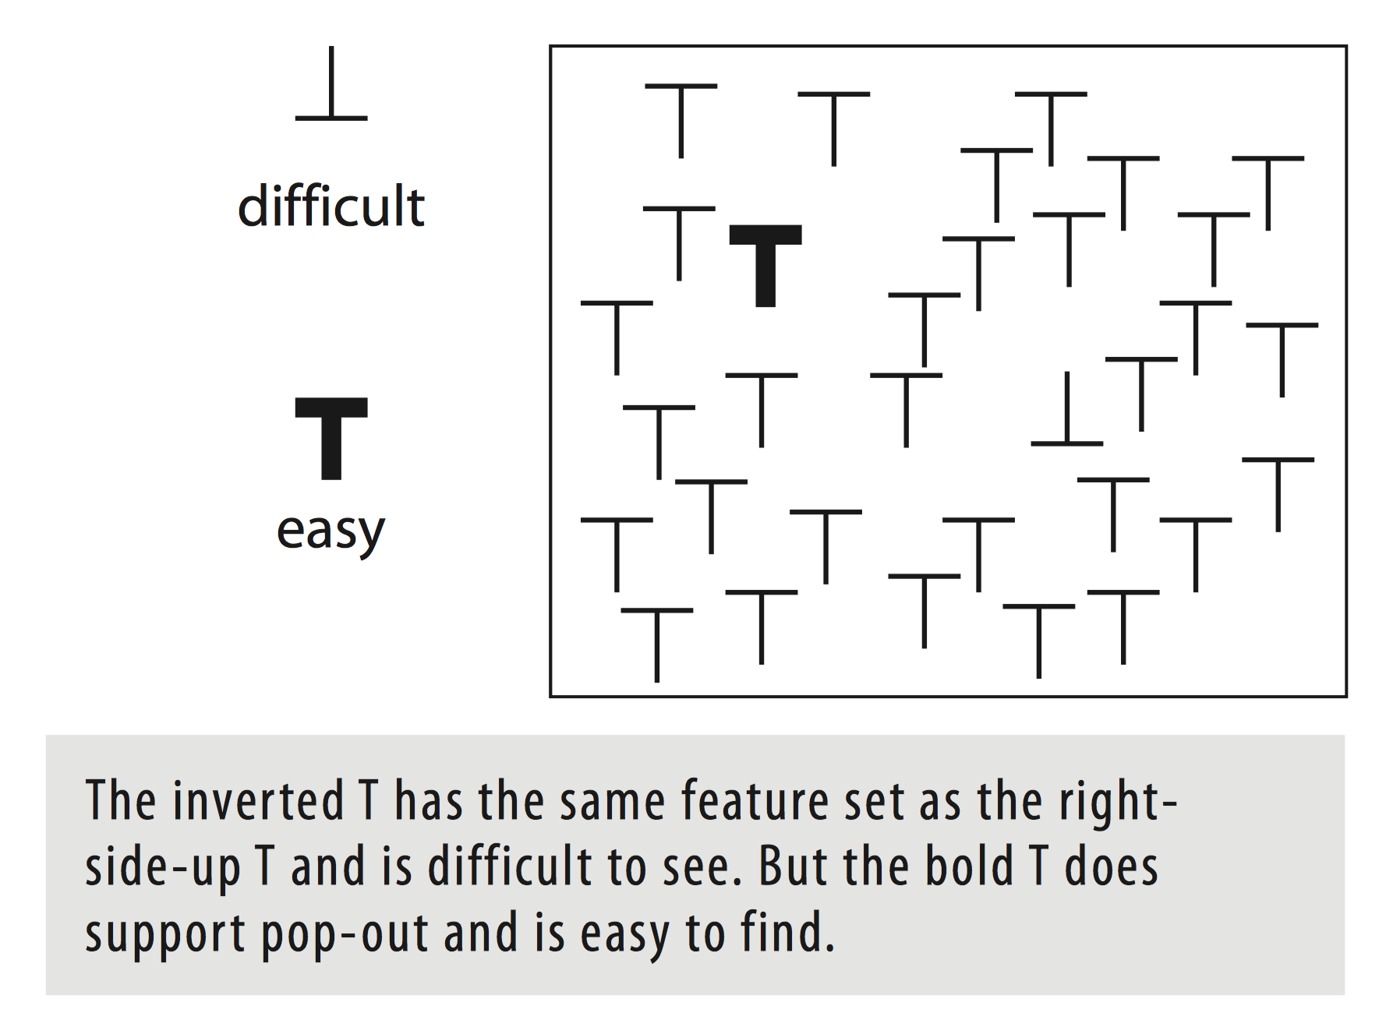

Slide 22

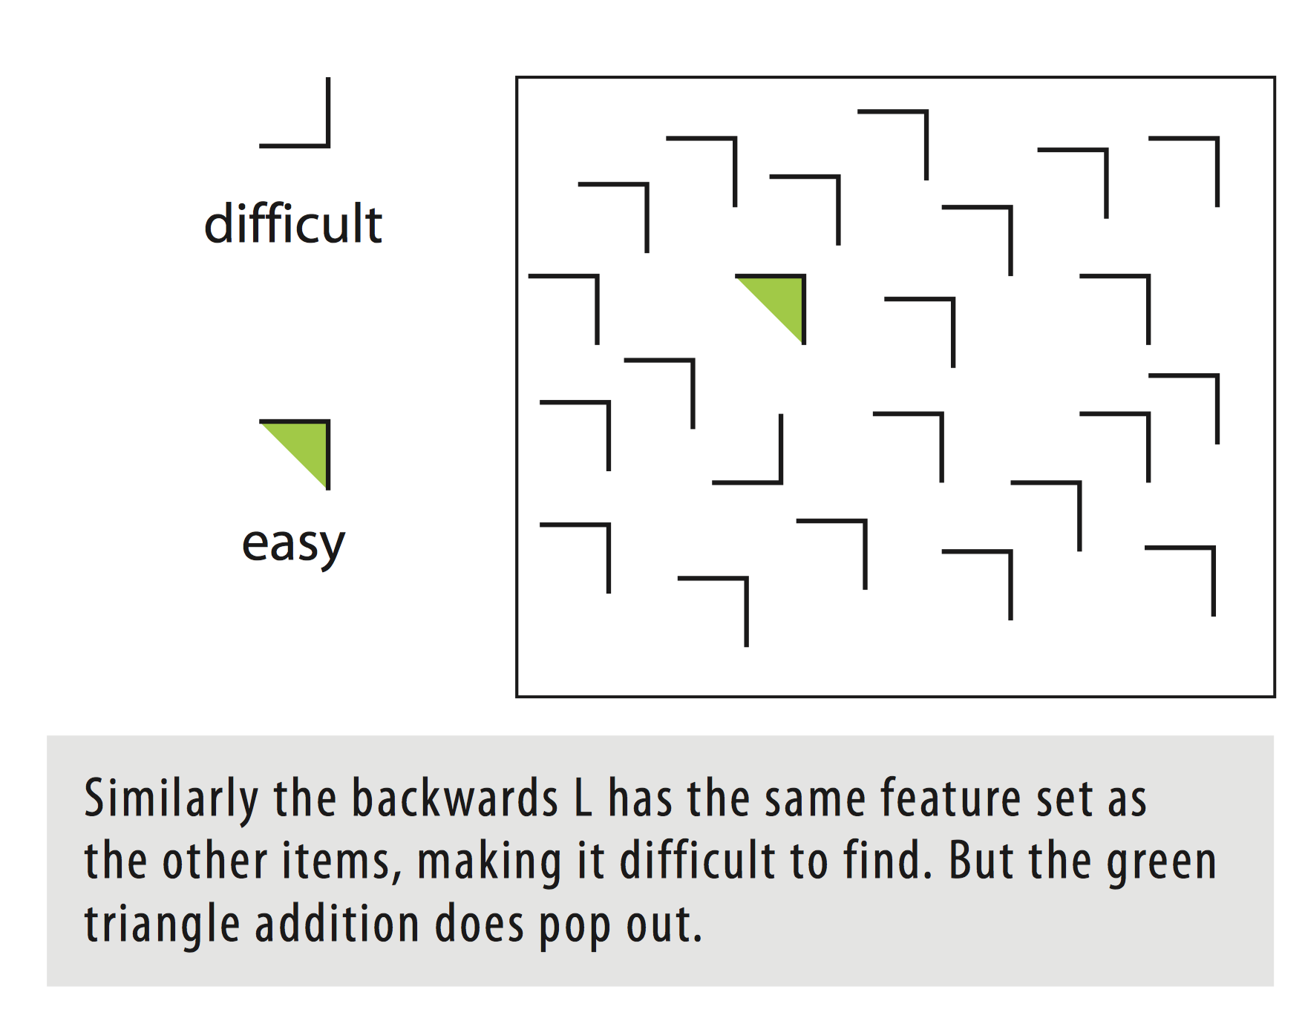

Slide 23

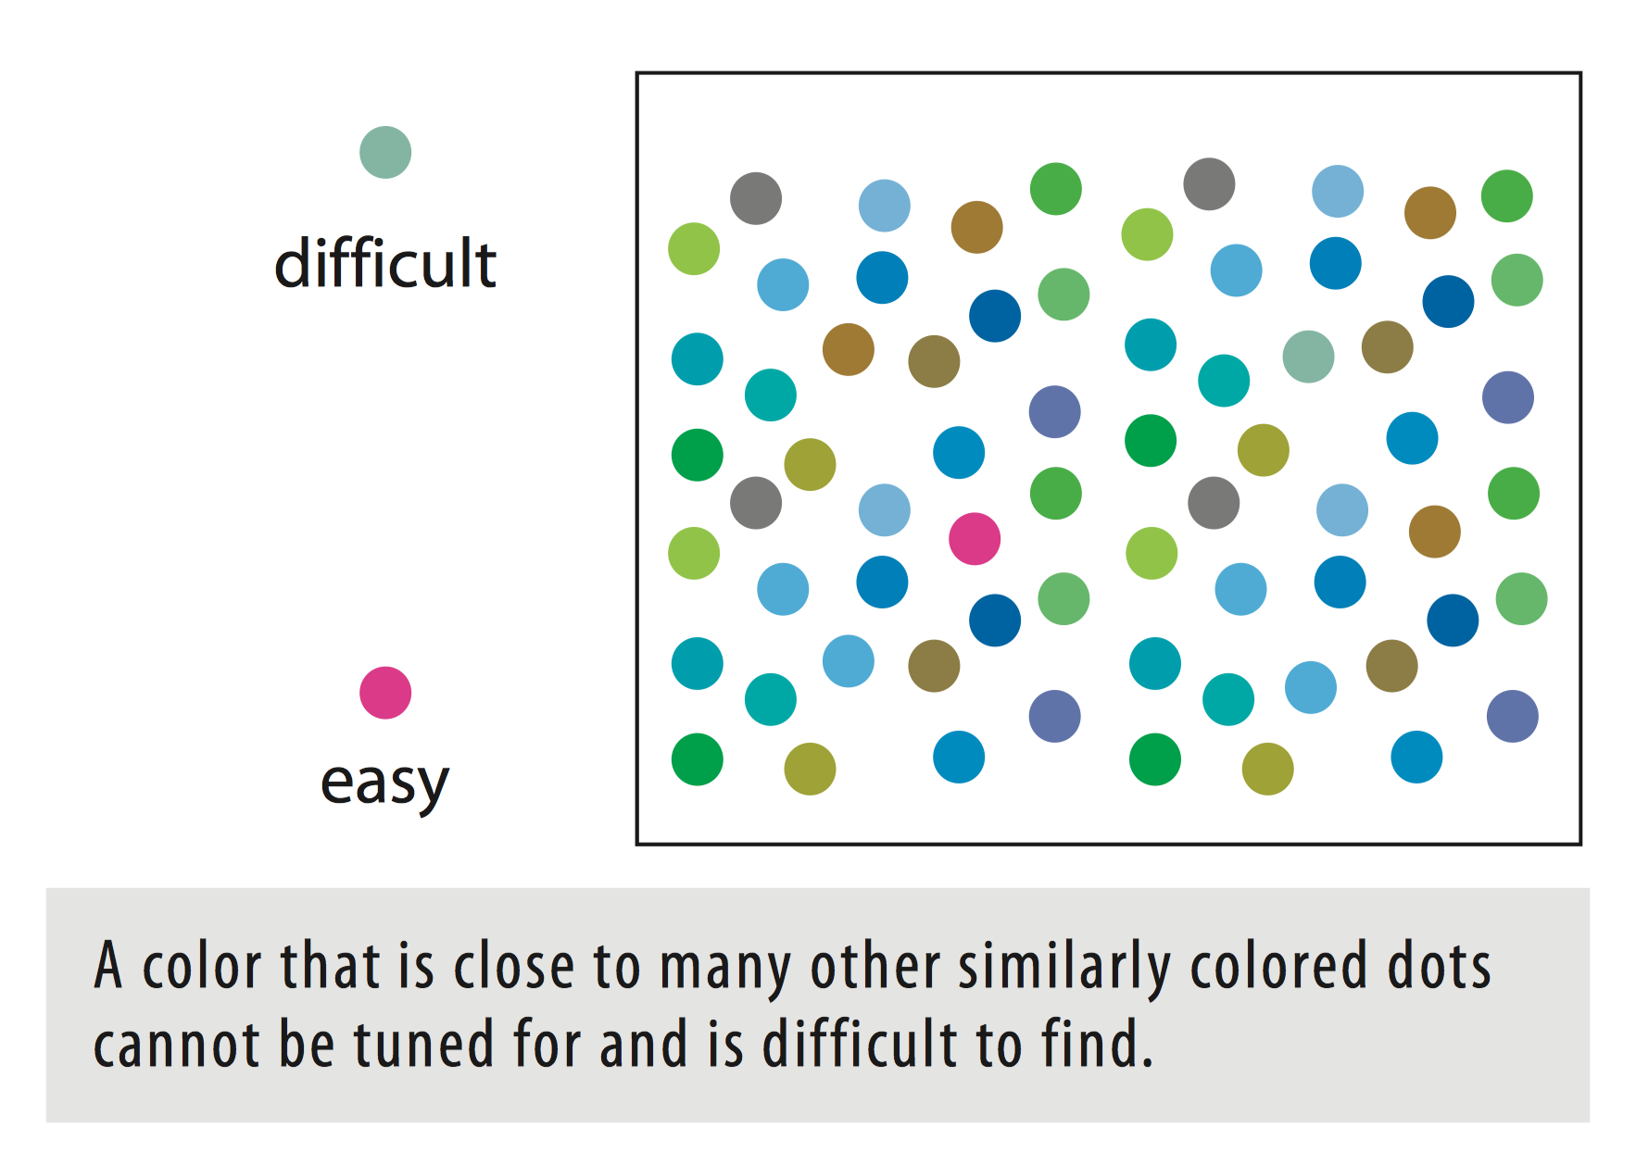

Slide 24

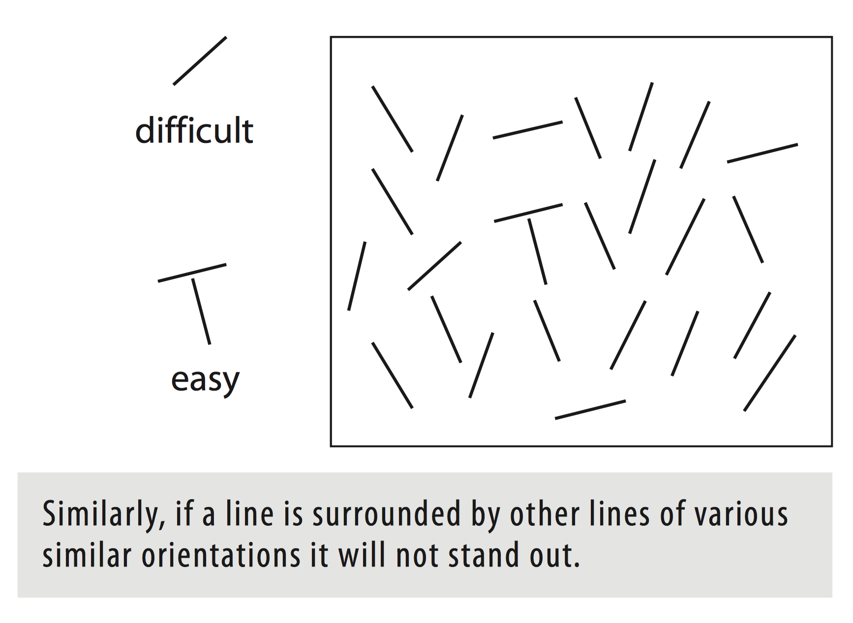

Slide 25
What Can We Do?
Use the concept of feature channels

Slide 26

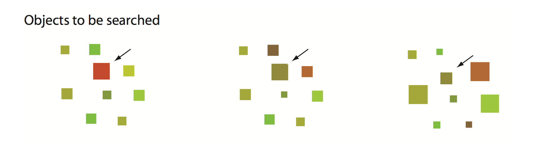

Slide 27

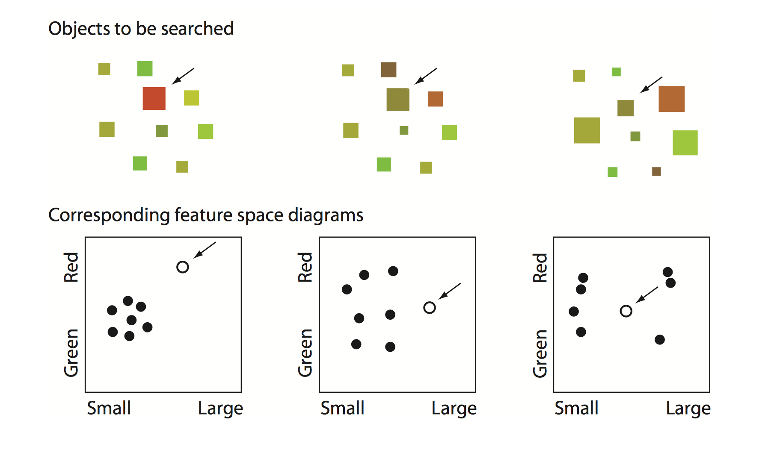

Slide 28
Takeaways for Design

Slide 29
Trivially, if you want to make something easy to find, make it different from its surroundings according to some primary visual channel
If you wish to make several things easily searchable at the same time, use different channels
E.g., plotting GDP vs. Population growth rate for countries for 4 different segments

Slide 30

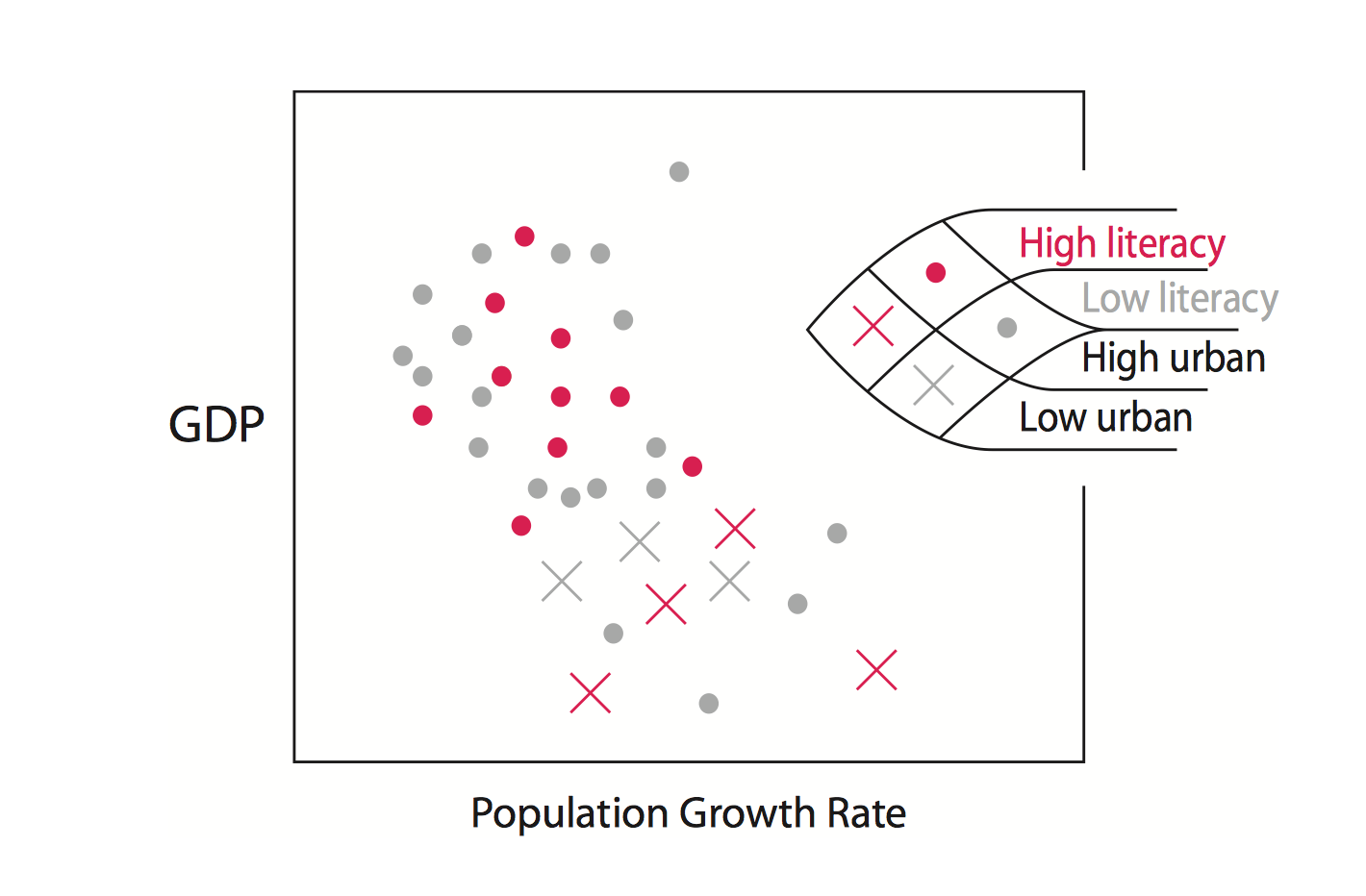
What else can you do?

Slide 31
It is a challenge to create a design having more than 2 or 3 symbols so that each one will support rapid pop-out searching
Creating a display containing more than 8 to 10 independently searchable symbols is probably impossible simply because there are not enough channels available
There is an inherent tradeoff between stylistic consistency and over-all clarity that every designer must come to terms with

Slide 32
Many kinds of visibility enhancements are not symmetric
Increasing the size of a symbol will result in something that is more distinctive than a corresponding decrease in size
An increase in contrast will be more distinctive than a decrease in contrast
Adding an extra part to a symbol is more distinctive than taking a part away

Slide 33


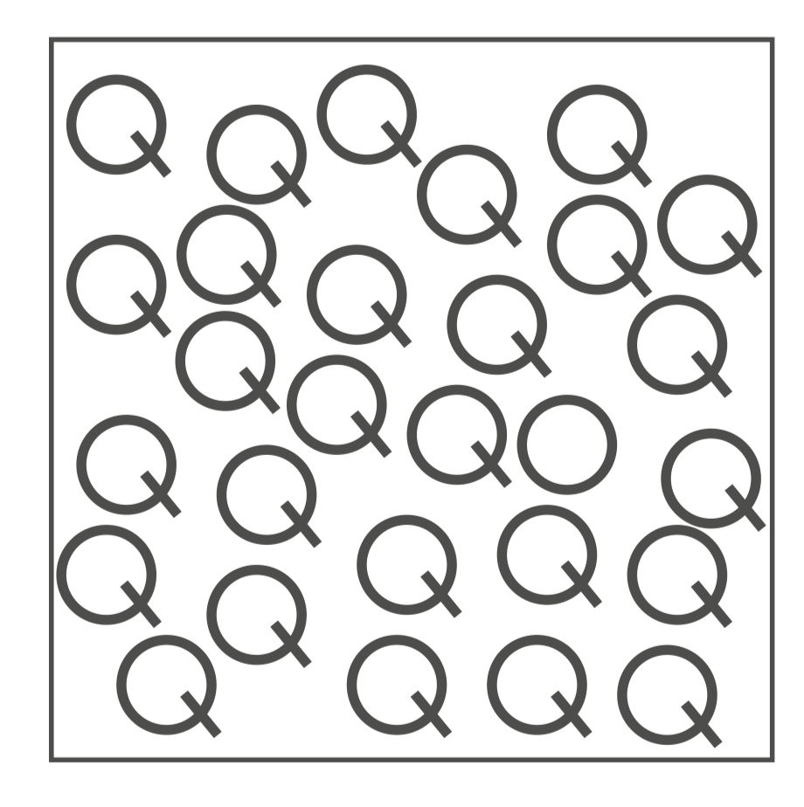
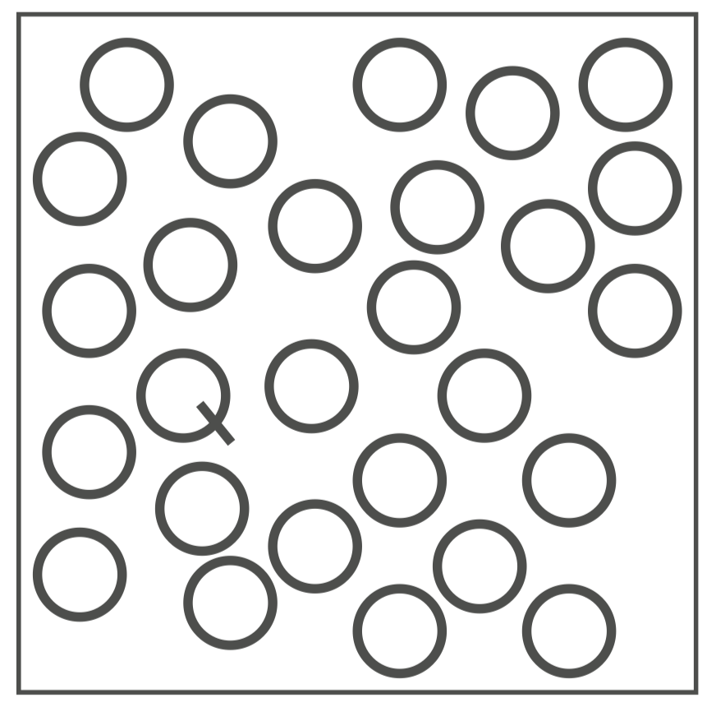

Slide 34
Motion is a powerful tool to generate an orienting response
The things that most powerfully elicit the orienting response are not simply things that move, but things that emerge into the visual ﬁeld
is an organism's immediate response to a change in its environment, when that change is not sudden enough to elicit the startle reflex

Slide 35


